Slide 1
West Australian Mines
Robbie, Caroline, Maria & Parkavi
Notes:
Apologies but two of our group members, Parkavi and Maria, are unable to join us today. Mining in Australia dates back to the 1880s, with the gold discoveries in Kalgoorlie and Coolgardie being the beginning of the gold rush AND the beginning of iron ore mining starting in the 1960s.

Slide 2
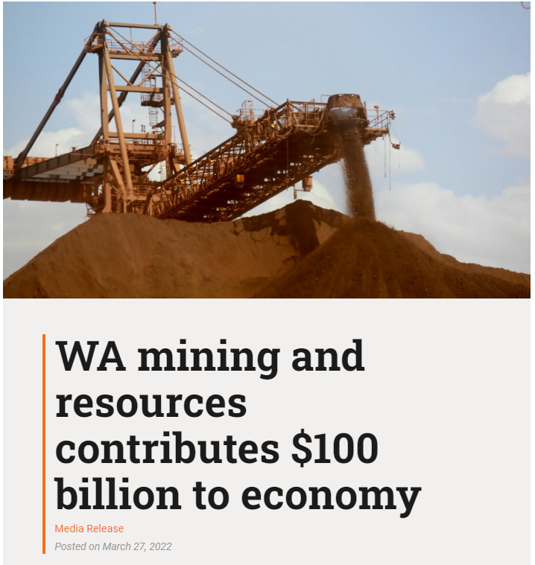
WA’s economy powerhouse
In 2020-21, 70,000 full time jobs and $100 billion dollars was contributed by the Mining Industry.
We took Data from from the Department of Mines, Industry Regulation and Safety highlighting the current operating mines in WA.
Notes:
Since those years mining has evolved in WA and wa now have an industry which in 2020-21 resulted in 70,000 full time jobs and $100 billion dollars contributed to the economy. Given the importance of this industry our group chose to look at mining data for our dashboard. The Department of Mines, Industry Regulation and Safety have a state-wide spatial dataset with all the operating mines in WA. This dataset is the basis of our work.

Slide 3
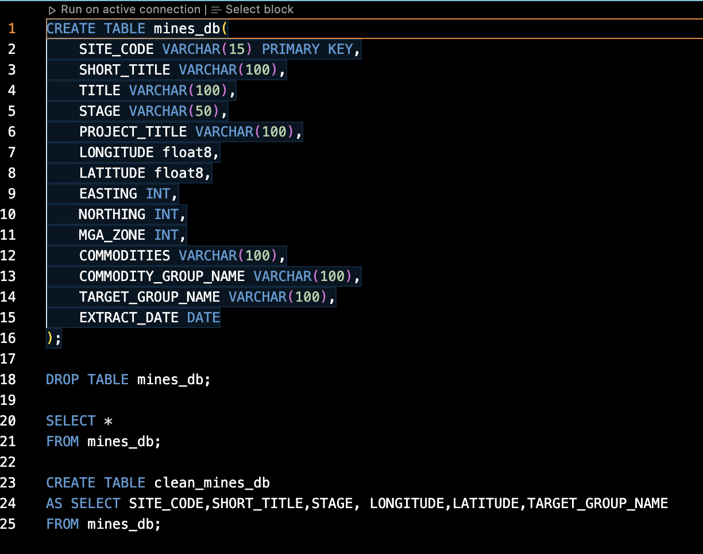
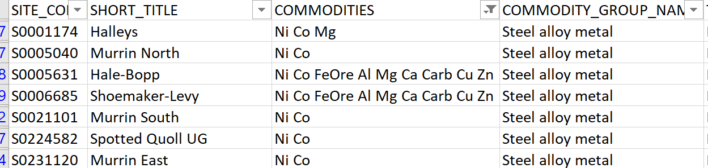
Process PostGRESQL
Notes:
We cleaned the data of the mines so that we can have the latitude and longitude the name of the project and the target commodity at the mine. As you can see from the snippet shared the data included ALL the commodities that are extracted at each particular mine. To assist with this project we narrowed our sample down to the four target commodities that occurred the most in our sample and that is Gold, Iron Ore, Nickel and Bauxite-Alumina.The cleaned data was then uploaded it into a database in PostGRES. The reason we chose this dataset was because of the large contribution to the WA economy and so we also needed info about the value of these commodities.

Slide 4
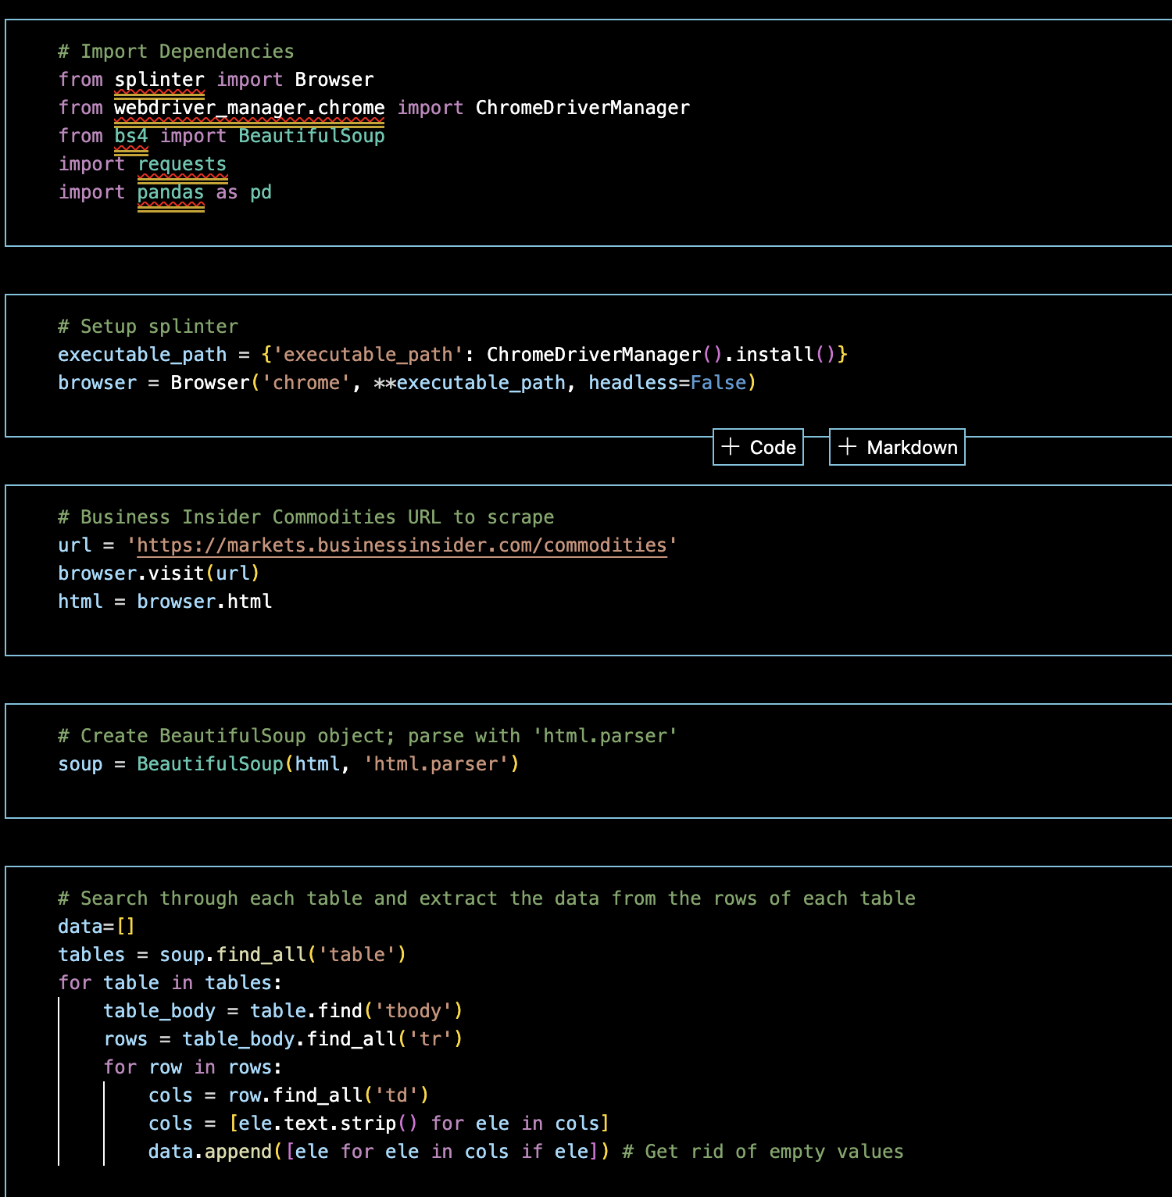
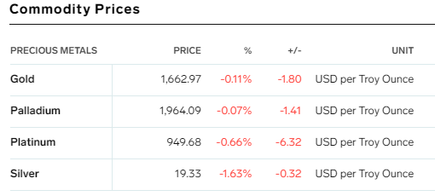
Process - Web scraping
Notes:
Which leads us to the scraping of Business Insider’s Commodity webpage. BeautifulSoup and Splinter were used to scrape the data. There are five tables that dynamically update on this page and so the scraper iterates through each table and then takes the data from each row. All the data scraped is then narrowed down to the four commodities that our presentation is looking at. Once we limit it to just these four the data is also uploaded into PostGres for use in the dashboard. I’ll now pass you on to Robbie who will discuss the new Javascript Library we utilised for our dashboard.

Slide 5
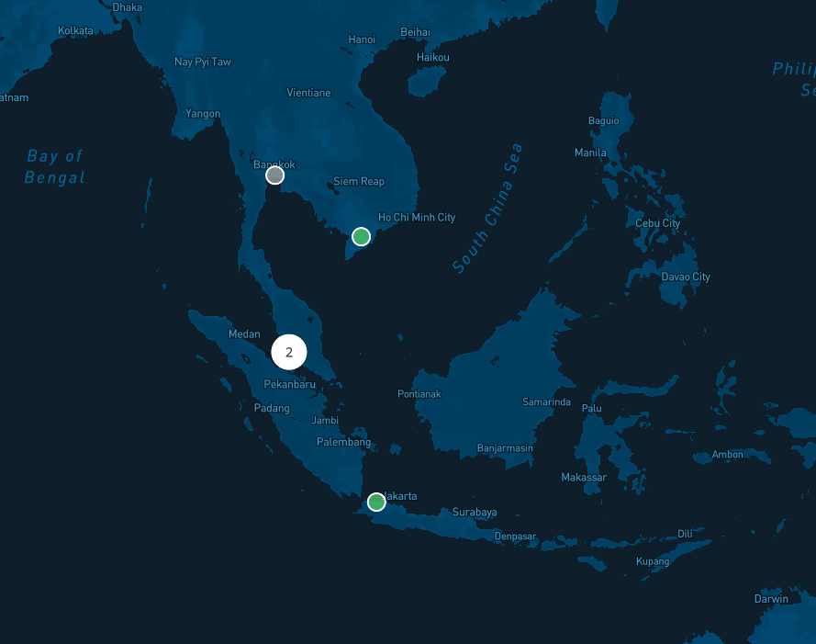
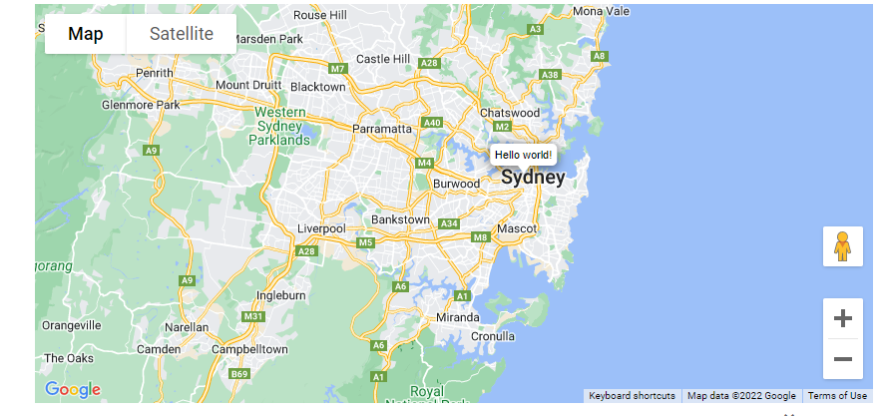
Inspiration
https://theoceancleanup.com/dashboard/#

Slide 6
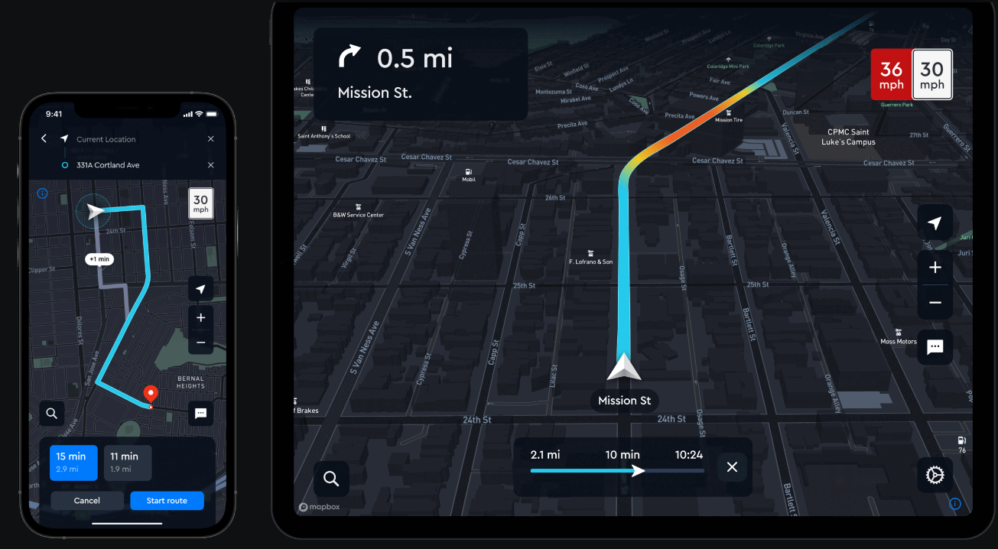
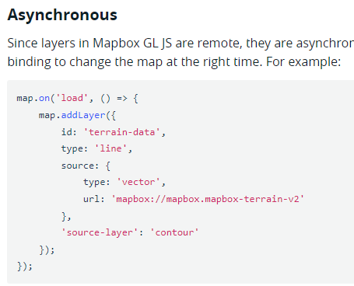
Mapbox GL JS
Notes:
Mapbox GL JS is a client-side JavaScript library for building web maps and web applications with Mapbox's modern mapping technology.

Slide 7
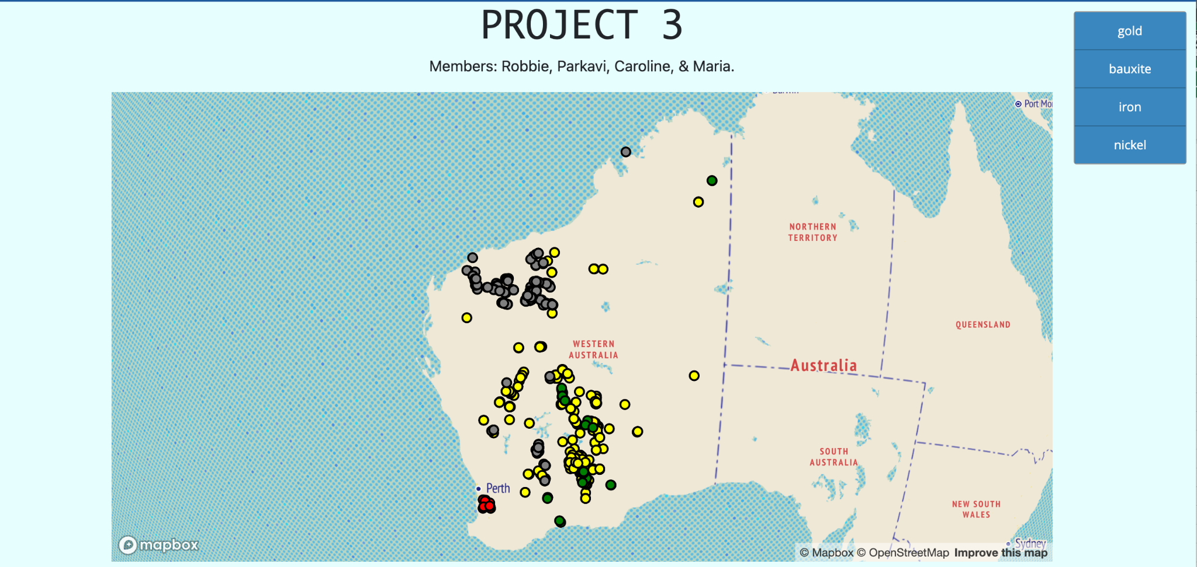
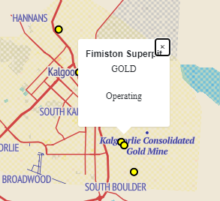
Dashboard

Slide 8
Questions?

